Slide 1
Javascript - 2026 Fall
Ci-Wei Lan 藍啟維
Dept. of CSE, NTOU

Slide 2
Course Outline
Objects & Output
  document, window and console objects
Basic Interaction
Variables & Data Types
  let, const (ES6)
  Primitives: string, number, boolean, undefined, null, bigint, symbol.
Operators & Control

Slide 3
JavaScript Overview
Javascript is a scripting language to enhance the functionality and appearance of web pages, i.e. make it alive for interaction with users.
JavaScript can execute not only in the browser, but also on the server, or actually on any device that has a special program called the JavaScript engine.
  V8 by Google: Google Chrome, Chromium browsers (Microsoft Edge, Brave, Opera), Node.js, Deno
  JavaScriptCore (Nitro / SquirrelFish) by Apple: Apple Safari (iOS, iPadOS, macOS), WebKit browsers, Bun runtime
  SpiderMonkey by Mozilla: Mozilla Firefox, Gecko-based projects
  Hermes by Meta: React Native apps (iOS & Android)

Slide 4
Short History of Javascript
1995: Initially created by Brendan Eich from Netscape and released.
  Named Mocha by the creator, which was later renamed to LiveScript.
1996: Renamed as JavaScript with hopes of capitalizing on the Java community.
1996: Netscape decided to submit it to ECMA International with the hopes of getting it standardized.
1997/1998/1999: ECMAScript 1/2/3 (ES1/2/3)
In-between: ES4 drafts (no agreements among major parties)
2009: ES5, mainly focusing on fixing the compatibility and security issues etc.
2015: ES6 (ES2015), allow writing complex applications, e.g. Classes, Modules, Destructuring, let and const etc.
2016: ES7 (ES2016), Exponentiation operator ** etc.
Yearly release model from 2016 on.

Slide 5
Add JavaScripts to HTML
<script> tags in the <head> section
  Browsers parse and execute scripts before contents in the <body> are parsed.
  Render-Blocking, no cache
<script> tags in the <body> section
  Generally place scripts just before </body> (contents are parsed) and thus better UX potentially.
  Partially render-blocking, no cache
Standalone JS files and are linked by <script> tag with a src attribute.
  Caching and Asynchronous Loading
defer and async attributes in <script>
  defer: scripts executed in the order they appear on the page AFTER entire document is parsed completely.
  async: scripts executed in the order they appear on the page AS SOON AS fetched completely.
<script async src="js/vendor/jquery.js"></script>
<script async src="js/script2.js"></script>
<script async src="js/script3.js"></script>

Slide 6
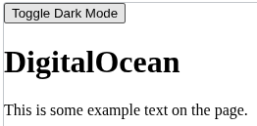
An Example of Javascript
<!DOCTYPE html>
<html lang="en-US">
<head>
<meta charset="UTF-8">
<meta name="viewport" content="width=device-width, initial-scale=1">
<title>Dark Mode</title>
<link rel="stylesheet" href="css/style.css">
</head>
<body>
<button id="theme-toggle">Toggle Dark Mode</button>
<h1 id="title">DigitalOcean</h1>
<p>This is some example text on the page.</p>
<script src="js/script.js"></script>
</body>
</html>
/* This class will be added or removed by JavaScript */
.dark-mode {
background-color: #222;
color: #eee;
}
const toggleButton = document.getElementById('theme-toggle');
toggleButton.addEventListener('click', function() {
document.body.classList.toggle('dark-mode');
});

Slide 7
Variables

Slide 8
Variables and Declaration
A variable is a named storage for data.
Declaration Keywords
  let: Modern declaration, allows reassignment
  const: Constant value, cannot be reassigned
  var: Legacy declaration, Function-scoped, avoid in modern code
Declarations end with a semicolon (;) and can be split over several lines, with each variable in the declaration separated by a comma (forming a comma-separated list of variable names)
  Several variables may be declared in one declaration or in multiple declarations.
let message = "Hello"; // reassignable
const pi = 3.14159; // constant
var legacy = "old"; // avoid
let message = "Hello", legacy = "old";
const pi = 3.14159;

Slide 9
Variable Naming Rules
Generally, you should stick to just using Latin characters (0-9, a-z, A-Z) and the underscore character.
Variables are case sensitive — so myage is a different variable from myAge.
Don't use underscores at the start of variable names — this is used in certain JavaScript constructs to mean specific things, so may get confusing.
Don't use numbers at the start of variables.
A safe convention to stick to is lower camel case, where you stick together multiple words, using lower case for the whole first word and then capitalize subsequent words.
  userName, shoppingCart.
Avoid using JavaScript reserved words
  var, function, let, and for

Slide 10
Variable Scopes
Global Scope
  Variables declared outside any function or block are globally accessible.
  All scripts and functions in the same web page can access a variable with global scope.
Function Scope
  Variables declared inside a function are local to that function.
  Local variables are created when the function starts and deleted when it ends.
  Identical variable names can exist in different functions without conflict.
Block Scope (ES6+)
  Introduced with let and const. Variables declared inside {} are accessible only within that block.
  var ignores block boundaries

Slide 11
Scope Examples
let carName = "Volvo";
// code here can use carName
function myFunction() {
// code here can also use carName
}
{
let x = 3;
const y = 4;
}
// x and y not accessible here
{
var z = 5;
}
console.log(z); // Works (not recommended)
function myFunction() {
const carName = "Volvo";
console.log(carName);
}
// console.log(carName); // Error: not defined

Slide 12
Variable Declaration and Assignment
A variable is assigned a value with an assignment statement, using the assignment operator, =.
  The = operator is called a binary operator, because it has two operands.
JavaScript does not require variables to have a type before they can be used in a script.
A variable in JavaScript can contain a value of any data type, and in many situations, JavaScript automatically converts between values of different types for you.
When a variable is declared in JavaScript, but is not given a value, it has an undefined value.
  Attempting to use the value of such a variable is normally a logic error.
  To indicate that a variable does not contain a value, you can assign the value null to it.

Slide 13
Automatically Global & Strict Mode
Assigning a value to an undeclared variable makes it global
In Strict Mode, undeclared variables cause errors — preventing accidental global creation.
  "use strict";
function myFunction() {
//use strict;
carName = "Volvo"; // becomes global
}

Slide 14

Hoisting
Hoisting is JavaScript’s behavior of moving declarations to the top of their scope before code execution.
Effect: Variables and functions can be used before they are declared, but only their declarations are hoisted — not initializations.
Variable hoisting
  var: value is initialized as undefined (still executable)
  let and const: value is not initialized and any access causes ReferenceError, i.e. variables are in so-called Temporal Dead Zone (TDZ).
console.log(a);
var a = 5;
console.log(a);
let a = 5;

Slide 15


Function Hoisting
Function declarations are fully hoisted — both name and body.
Function expressions are not hoisted:
greet(); // Error
var greet = function() { console.log("Hi!"); };
greet(); // Works
function greet() { console.log("Hello!"); }

Slide 16
Primitive Data Types

Slide 17
Primitive Data Types
All types except Object define immutable values represented directly at the lowest level of the language. We refer to values of these types as primitive values.
All primitive types, except null, can be tested by the typeof operator. typeof null returns "object", so one has to use === null to test for null.
All primitive types, except null and undefined, have their corresponding object wrapper types, which provide useful methods for working with the primitive values.
  For example, the Number object provides methods like toExponential().
  Auto-boxing: When a property is accessed on a primitive value, JavaScript automatically wraps the value into the corresponding wrapper object and accesses the property on the object instead.

Slide 18

Auto-Boxing Illustration Example
const str = "hello"; // Primitive string
// 1. Try to add a property
str.customProp = "world";
// JS auto-boxing per value type
// 2. Try to access the added property
console.log(str.customProp);

Slide 19
Overview of Primitive Data Types
Data Type | Description | Example
Number | 64-bit floating-point values; includes integers, decimals, and special values like Infinity, -Infinity, and NaN. | let n = 42;
BigInt | Arbitrary-length integers beyond safe integer range (±(2^53 - 1)). Created with n suffix. | 123456789012345678901n
String | Textual data, immutable, enclosed in quotes (", ', `). Backticks allow interpolation. | `Hello ${name}`
Boolean | Logical values true or false, often used in conditions. | let isActive = true;
Null | Special value representing “nothing” or “unknown.” | let age = null;
Undefined | Default value for uninitialized variables. | let x; // undefined
Symbol | Unique, immutable identifiers often used as object property keys. | Symbol("id")

Slide 20
Number & BigInt
Number
  Stored as 64‑bit floating point.
  Includes integers, decimals, Infinity, -Infinity, and NaN.
  Quirks:
    NaN !== NaN (only value not equal to itself).
    Precision issues: 0.1 + 0.2 === 0.3 → false.
    Division by zero → Infinity or -Infinity
BigInt
  Represents integers of arbitrary length.
  Created with n suffix: 123456789012345678901n.
  Cannot mix with Number in arithmetic (TypeError).
console.log(Number.MAX_SAFE_INTEGER); // 9007199254740991
console.log(9007199254740991 + 1 === 9007199254740991 + 2); // true
console.log(9007199254740991n + 1n === 9007199254740991n + 2n); // false

Slide 21
Quirks in JS Number
現象 | 範例 | 結果 | 原因
NaN 不等於自己 | NaN === NaN | false | ECMAScript 規範
浮點數誤差 | 0.1 + 0.2 === 0.3 | false | IEEE 754
除以 0 | 1 / 0 | Infinity | IEEE 754
0 除以 0 | 0 / 0 | NaN | 無法定義
Infinity 型別 | typeof Infinity | "number" | Infinity 是 Number
null 型別 | typeof null | "object" | 歷史 Bug

Slide 22


String & Boolean
String
  Immutable sequences of characters.
  Declared with ", ', or backticks `.
  Backticks allow interpolation:
Boolean
  Logical values: true or false.
  Commonly used in conditions:
let isActive = true;
if (isActive) {
console.log("User is active");
}
let name = "Charlie";
console.log(`Hello, ${name}!`);
let name = "Tom";
let msg = `Hello ${name}`;
console.log(msg);
Hello Tom

Slide 23


Null, Undefined, & Symbol
Null
  Intentional absence of value.
  Example: let age = null;
Undefined
  Default for uninitialized variables or missing properties.
Symbol
  Unique, immutable identifiers.
  Often used as object property keys to avoid collisions.
let id1 = Symbol("id");
let id2 = Symbol("id");
console.log(id1 === id2); // false
let x;
console.log(x); // undefined

Slide 24
Common Pitfalls
typeof null returns "object" (a historical bug).
Mixing BigInt and Number throws TypeError.
Implicit coercion: "42" + 1 → "421" (string concatenation), while "42" - 1 → 41 (numeric subtraction).

Slide 25
Check Data Type by typeof Operator

Slide 26
JavaScript Operator ─ typeof
The typeof operator in JavaScript returns a string describing the type of a given operand.
  Widely used for debugging and type-checking
"undefined" → for undefined or undeclared variables
"object" → for objects, arrays, dates, regex, and null
"boolean" → for true/false
"number" → for numbers, NaN, Infinity
"bigint" → for BigInt literals (42n)
"string" → for text values
"symbol" → for Symbol()
"function" → for functions and classes
typeof 42; // "number"
typeof "hello"; // "string"
typeof true; // "boolean"
typeof undefined; // "undefined"
typeof {a:1}; // "object"
typeof [1,2,3]; // "object"
typeof function() {}; // "function"
typeof null; // "object"

Slide 27
typeof ─ Notes and Practices
Special Cases:
  null returns "object" due to legacy design in early JavaScript implementations.
  Arrays also return "object"
    use Array.isArray() for detection.
  Undeclared variables: typeof undeclaredVar → "undefined" (no error thrown).
  Block-scoped variables (let, const, class): Using typeof before declaration throws a ReferenceError because of the temporal dead zone.
  document.all: Returns "undefined" in browsers, a deliberate standards violation for compatibility
Practical Tips:
  Use Array.isArray() to distinguish arrays from objects.
  Use Object.prototype.toString.call(value) for more precise type detection.
  Be cautious with null and wrapper objects (new Number(), new String()), which return "object".
  Parentheses may be needed when checking expressions:
    typeof (99 + “foo”); //string

Slide 28
Type Casting

Slide 29
Implicit Type Conversion (Coercion)
Type conversion is done by JavaScript automatically.
<html>
<head>
<title>Implicit conversion to string </title>
</head>
<body>
<script>
document.write("100" + 24 + "<br/>");
document.write('100' + false + "<br/>");
document.write("100" + null+ "<br/>");
document.write("100" + undefined+ "<br/>");
</script>
</body>
</html>
console.log('100' / 50);
console.log('100' - '50');
console.log('100' * true);
console.log('100' - false);
console.log('tp' / 50);
let num = 100 + undefined;

Slide 30
Explicit Type Conversion
Convert the data type of the variable manually
<html>
<head>
<title> Converting to string explicitly </title>
</head>
<body>
<script>
document.write(typeof String(100) + "<br/>");
document.write(typeof String(null)+ "<br/>");
document.write(typeof String(true) + "<br/>");
</script>
</body>
</html>
const num = 100;
num.toString() // converts 100 to '100'
Number('100'); // Converts '100' to 100
Number(false); // Converts false to 0
Number(null); // Converts null to 0
num = +"200"; // Using the unary operator

Slide 31
Conversion Table in JavaScript
Value | String conversion | Number conversion | Boolean conversion
0 | "0" | 0 | false
1 | "1" | 1 | true
"1" | "1" | 1 | true
"0" | "0" | 0 | true
"" | "" | 0 | false
"Hello" | "Hello" | NaN | true
true | "true" | 1 | true
false | "false" | 0 | false
null | "null" | 0 | false
undefined | "undefined" | NaN | false
[50] | "50" | 50 | true
[50, 100] | "[50, 100]" | NaN | true

Slide 32
Data Type ─ Object

Slide 33
Javascript Object
JavaScript is designed on an object-based paradigm.
An object is a collection of properties.
A property is an association between a name (or key) and a value.
A property's value can be a function, in which case the property is known as a method.
const myCar = {
color: "red",
wheels: 4,
engine: { cylinders: 4, size: 2.2 },
};

Slide 34
Creating new objects ─ Using object initializers
Object initializers are also called object literals. "Object initializer" is consistent with the terminology used by C++.
In the example, newly created object is assigned to a variable obj — this is optional.
  Usage: function arguments, chaining / immediate method call, array elements, immediate destructuring, instantiation for side-effects.
  Disposable, Clean Scope, Garbage Collection
const obj = {
property1: value1, // property name may be an identifier
2: value2, // or a number
"property n": value3, // or a string
};

Slide 35
Creating new objects ─ Using a constructor function
Define the object type by writing a constructor function. There is a strong convention, with good reason, to use a capital initial letter.
  To define an object type, create a function for the object type that specifies its name, properties, and methods.
Create an instance of the object with new.
function Car(make, model, year) {
this.make = make;
this.model = model;
this.year = year;
}
const myCar = new Car("Eagle", "Talon TSi", 1993);
myCar.color = "Silver";

Slide 36
Creating new objects ─ Using Object.create()
Objects can also be created using the Object.create() method.
This method can be very useful, because it allows you to choose the prototype object for the object you want to create, without having to define a constructor function.
// 1. Define a prototype object (parent)
const personPrototype = {
greet() {
console.log(`Hello, my name is ${this.name}!`);
},
isAdult() {
return this.age >= 18;
}
};
// 2. Create a new object that inherits from personPrototype
const user = Object.create(personPrototype);
// 3. Add own properties to the newly created object
user.name = "Alex";
user.age = 28;
// 4. Use inherited methods
user.greet(); // Output: Hello, my name is Alex!
console.log(user.isAdult()); // Output: true

Slide 37
Javascript Object ─ Accessing properties
Two syntaxes: dot notation and bracket notation.
More advanced cases on accessing by dot or bracket:
  https://developer.mozilla.org/en-US/docs/Web/JavaScript/Guide/Working_with_objects#accessing_properties
const myObj = {};
const str = "myString";
const rand = Math.random();
const anotherObj = {};
// Create additional properties on myObj
myObj.type = "Dot syntax for a key named type";
myObj["date created"] = "This key has a space";
myObj[str] = "This key is in variable str";
myObj[rand] = "A random number is the key here";
myObj[anotherObj] = "This key is object anotherObj";
myObj[""] = "This key is an empty string";
console.log(myObj);
console.log(myObj.str);
let propertyName = "make";
myCar[propertyName] = "Ford";
// access different properties by changing the contents of the variable
propertyName = "model";
myCar[propertyName] = "Mustang";
console.log(myCar); // { make: 'Ford', model: 'Mustang' }

Slide 38
Javascript Object ─ Deleting properties
You can remove a non-inherited property using the delete operator. The following code shows how to remove a property.
// Creates a new object, myObj, with two properties, a and b.
const myObj = { a: 5, b: 12 };
// Removes the a property, leaving myObj with only the b property.
delete myObj.a;
console.log("a" in myObj); // false

Slide 39
Object Inheritance
All objects in JavaScript inherit from at least one other object.
  Inheritance is automatic
The object being inherited from is known as the prototype, and the inherited properties can be found in the prototype object of the constructor.
  When you create an object using a constructor function, JavaScript automatically attaches a hidden link (__proto__) from the new object to the constructor’s prototype object. This automatic linkage is why all objects inherit properties and methods, even though the word prototype does not explicitly appear in your code.
prototype: An object automatically created for every constructor function. Any key–value properties or function properties added to this prototype are shared by all instances created with new Constructor(), because they all link to the same prototype object.
__proto__: A property on every object whose value is a reference to another object — specifically, the constructor’s prototype. This hidden link forms the prototype chain, enabling inheritance of shared properties and methods.

Slide 40
An Example of Object Inheritance
// Constructor function
function Person(name) {
this.name = name;
}
// Add a method to the prototype
Person.prototype.greet = function() {
console.log(`Hi, I'm ${this.name}`);
};
// Create an instance
const alice = new Person("Alice");
// Even though we never wrote "prototype" in the new statement,
// the system automatically linked alice.__proto__ to Person.prototype
console.log(alice.__proto__ === Person.prototype); // true
// alice can use greet because it's found in Person.prototype
alice.greet(); // "Hi, I'm Alice"

Slide 41
Object getters and setters Functions ─ Object literal
A getter is a function associated with a property that gets the value of a specific property.
  must not expect a parameter
A setter is a function associated with a property that sets the value of a specific property.
  expects exactly one parameter (the new value to set)
const myObj = {
a: 7, // 一般屬性（資料屬性）
get b() { // 讀取 myObj.b 時執行
return this.a + 1;
},
set c(x) { // 寫入 myObj.c = ... 時執行
this.a = x / 2;
},
};
console.log(myObj.a); // 7
console.log(myObj.b); // 8，不是呼叫函式，但自動執行 getter：7 + 1
myObj.c = 50; // 不是存到 c，而是執行 setter：a = 50 / 2 = 25
console.log(myObj.a); // 25
console.log(myObj.b); // 26，b 跟著 a 變

Slide 42
Object getters and setters Functions ─ defineProperties
const myObj = { a: 0 };
Object.defineProperties(myObj, {
b: {
get() {
return this.a + 1;
},
},
c: {
set(x) {
this.a = x / 2;
},
},
});

Slide 43
Standard Built-in Objects and Global Properties

Slide 44
Global Properties
NaN property
  represents "Not-a-Number" value
  https://developer.mozilla.org/en-US/docs/Web/JavaScript/Reference/Global_Objects/NaN
Infinity property
  The Infinity global property is a numeric value representing infinity.
  https://developer.mozilla.org/en-US/docs/Web/JavaScript/Reference/Global_Objects/Infinity
undefined property
  The undefined global property represents the primitive value undefined. It is one of JavaScript's primitive types.
  https://developer.mozilla.org/en-US/docs/Web/JavaScript/Reference/Global_Objects/undefined

Slide 45
Math Object
Math object methods enable you to conveniently perform many common mathematical calculations.
An object’s methods are called by writing the name of the object followed by a dot operator (.) and the name of the method.
In parentheses following the method name are arguments to the method.
https://developer.mozilla.org/en-US/docs/Web/JavaScript/Reference/Global_Objects/Math

Slide 46
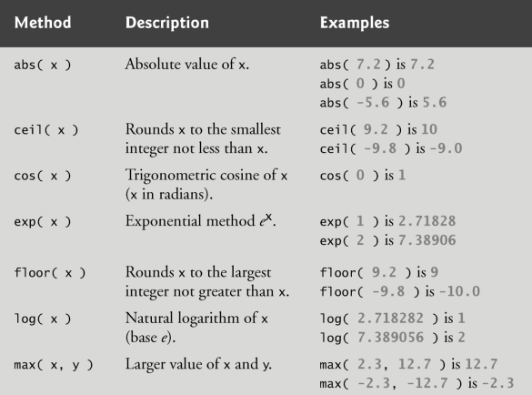
Math Object Methods

Slide 47
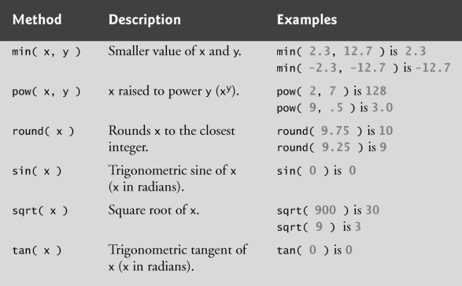
Math Object Methods (Cont.)

Slide 48
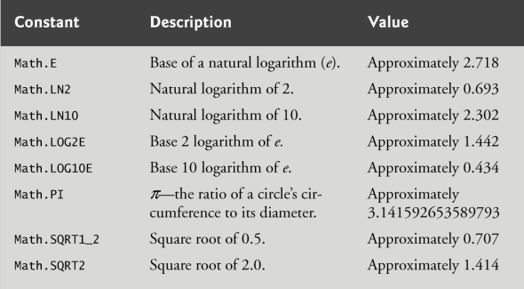
Math Static properties

Slide 49
String Object
Characters are the building blocks of JavaScript programs.
  Every program is composed of a sequence of characters grouped together that is interpreted by the computer as a series of instructions used to accomplish a task.
A string is a series of characters treated as a single unit.
A string may include letters, digits and various special characters, such as +, -, *, /, and $.
JavaScript supports Unicode, which represents a large portion of the world’s languages.
String literals or string constants are written as a sequence of characters in double or single quotation marks.
https://developer.mozilla.org/en-US/docs/Web/JavaScript/Reference/Global_Objects/String

Slide 50
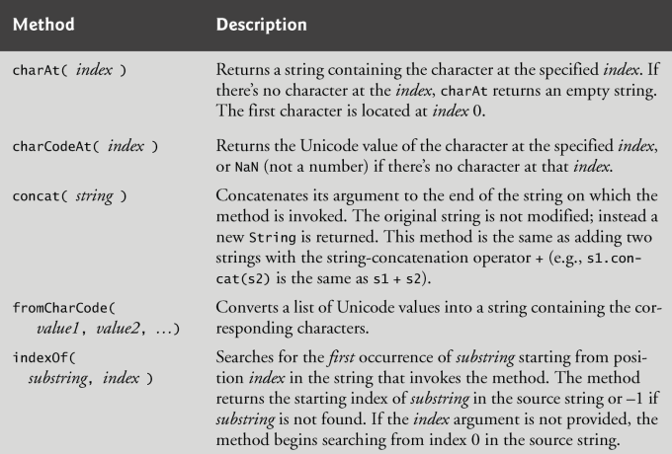
String Object Methods

Slide 51
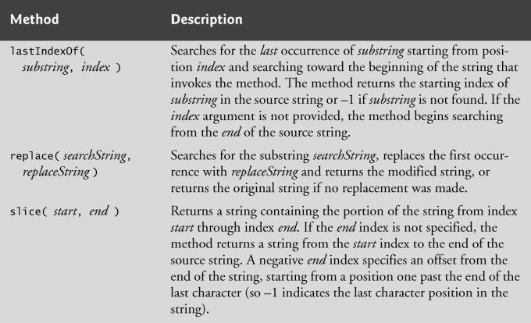
String Object Methods (Cont.)

Slide 52
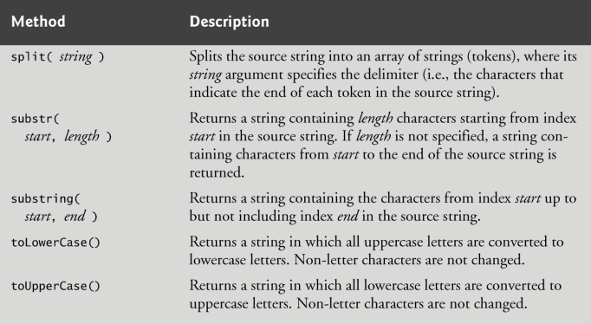
String Object Methods (Cont.)

Slide 53
Character Processing Methods
String method charAt
  Returns the character at a specific position.
  Indices for the characters in a string start at 0 (the first character) and go up to (but do not include) the string’s length.
  If the index is outside the bounds of the string, the method returns an empty string.
String method charCodeAt
  Returns the Unicode value of the character at a specific position.
  If the index is outside the bounds of the string, the method returns NaN.
String method fromCharCode
  Returns a string created from a series of Unicode values.
String method toLowerCase
  Returns the lowercase version of a string.
String method toUpperCase
  Returns the uppercase version of a string.

Slide 54
String Search Methods
String method indexOf
  Determines the location of the first occurrence of its argument in the string used to call the method.
  If the substring is found, the index at which the first occurrence of the substring begins is returned; otherwise, -1 is returned.
  Receives an optional second argument specifying the index from which to begin the search.
String method lastIndexOf
  Determines the location of the last occurrence of its argument in the string used to call the method.
  If the substring is found, the index at which the last occurrence of the substring begins is returned; otherwise, -1 is returned.
  Receives an optional second argument specifying the index from which to begin the search.

Slide 55
String Split and Substring
Breaking a string into tokens is called tokenization.
Tokens are separated from one another by delimiters, typically white-space characters such as blank, tab, newline and carriage return.
  Other characters may also be used as delimiters to separate tokens.
String method split
  Breaks a string into its component tokens.
  Argument is the delimiter string.
  Returns an array of strings containing the tokens.
String method substring
  Returns the substring from the starting index (its first argument) up to but not including the ending index (its second argument).

Slide 56
Date Object
Date object provides methods for date and time manipulations.
Based either on the computer’s local time zone or on World Time Standard’s Coordinated Universal Time (abbreviated UTC).
https://developer.mozilla.org/en-US/docs/Web/JavaScript/Reference/Global_Objects/Date

Slide 57
Date Object (Cont.)
Empty parentheses after an object name indicate a call to the object’s constructor with no arguments.
  A constructor is an initializer method for an object.
  Called automatically when an object is allocated with new.
  The Date constructor with no arguments initializes the Date object with the local computer’s current date and time.
  A new Date object can be initialized by passing the number of milliseconds since midnight, January 1, 1970, to the Date constructor.
Can also create a new Date object by supplying arguments to the Date constructor for year, month, date, hours, minutes, seconds and milliseconds.
  Hours, minutes, seconds and milliseconds arguments are all optional.
  If any one of these arguments is not specified, a zero is supplied in its place.
  If an argument is specified, all arguments to its left must be specified.

Slide 58
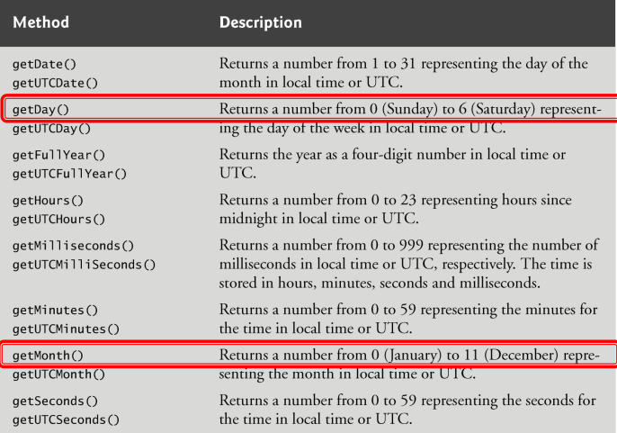
Date Object Methods

Slide 59
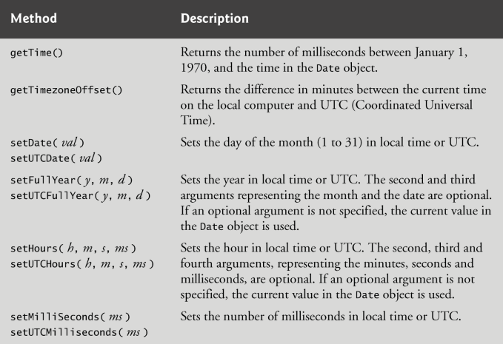
Date Object Methods (Cont.)

Slide 60
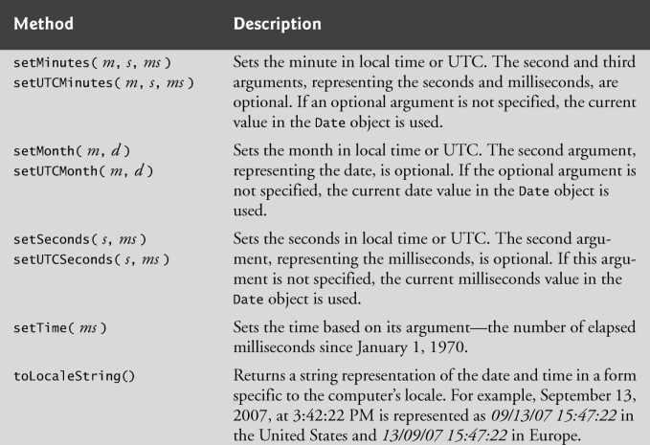
Date Object Methods (Cont.)

Slide 61
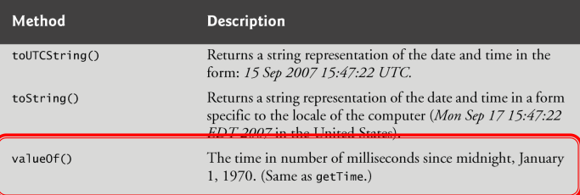
Date Object Methods (Cont.)

Slide 62
Object Type ─ Arrays Data Structure

Slide 63
Array Object
The Array object, as with arrays in other programming languages, enables storing a collection of multiple items under a single variable name, and has members for performing common array operations.
  Built-in methods: map(), filter(), reduce(), push(), and pop() etc.
JavaScript arrays are resizable and can contain a mix of different data types.
Not associative arrays and so, array elements cannot be accessed using arbitrary strings as indexes, but must be accessed using nonnegative integers (or their respective string form) as indexes.
Zero-indexed.
JavaScript array-copy operations create shallow copies.
  Only the top-level properties are copied, not the values of nested objects.
    Re-assigning top-level properties of the copy does not affect the source object.
    Re-assigning nested object properties of the copy does affect the source object.

Slide 64
Array Examples
const fruits = ['Apple', 'Banana'];
fruits["favorite"] = 'Mango';
console.log(fruits["favorite"]);
// "Mango"
console.log(fruits.length);
// 2
const ingredientsList = ["noodles", { list: ["eggs", "flour", "water"] }];
const ingredientsListCopy = Array.from(ingredientsList);
console.log(ingredientsListCopy);
// ["noodles",{"list":["eggs","flour","water"]}]
ingredientsListCopy[1].list = ["rice flour", "water"];
console.log(ingredientsList[1].list);
// Array [ "rice flour", "water" ]
ingredientsListCopy[0] = "rice noodles";
console.log(ingredientsList[0]); // noodles
console.log(JSON.stringify(ingredientsListCopy));
// ["rice noodles",{"list":["rice flour","water"]}]
console.log(JSON.stringify(ingredientsList));
// ["noodles",{"list":["rice flour","water"]}]

Slide 65
Array Element and Element Access
An array is a group of memory locations
  All have the same name and normally are of the same type (although this attribute is not required in JavaScript).
Each individual location is called an element.
We may refer to any one of these elements by giving the array’s name followed by the position number of the element in square brackets ([])
  The ith element of array fruits is referred to as fruits[i-1].
Every array in JavaScript knows its own length, which it stores in its length attribute and can be found with the expression, e.g. fruits.length.

Slide 66
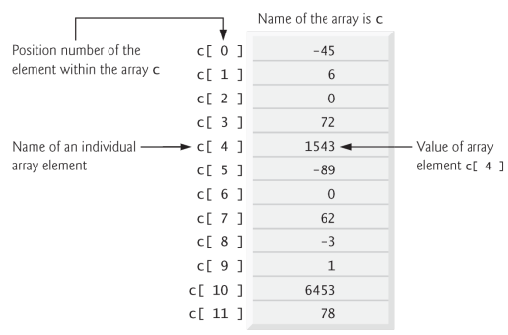
A Simple Array Illustration

Slide 67
Array Reallocation
JavaScript automatically reallocates an Array when a value is assigned to an element that is outside the bounds of the original Array . Elements between the last element of the original Array and the new element are undefined.
const fruits = ['Apple', 'Banana', 'Orange'];
console.log(fruits.length); // Output: 3
// 💡 Assigning a value to index "6", which is far beyond the original bounds
fruits[6] = 'Mango';
console.log(fruits.length); // Output: 7 (automatically reallocated)
console.log(fruits[3]); // Output: undefined (automatically filled in between)
console.log(fruits[4]); // Output: undefined (automatically filled in between)
console.log(fruits[5]); // Output: undefined (automatically filled in between)
console.log(fruits[6]); // Output: "Mango" (newly assigned value)
console.log(fruits);
// ['Apple', 'Banana', 'Orange', empty × 3, 'Mango']

Slide 68
Array Creation Approaches
Array Literal Notation ([])
  Syntax: const arr = [element1, element2, ...];
  Behavior: Directly initializes an array with the specified values.
  Best Practice: Preferred standard method. It is cleaner, safer, easier to read, and avoids unintended edge cases.
Array Constructor (new Array())
  Syntax: const arr = new Array(args...);
  Behavior Depends on Arguments:
    Multiple Arguments or Non-Number: Creates an array containing those elements.
      new Array('Apple', 'Banana') -> ['Apple', 'Banana']
    A Single Number: Creates an empty sparse array with its length property set to that number (it does not create an array with that single number as an element).
      new Array(5) -> Creates an array of length 5 with no initialized elements (empty × 5).
[5] vs. new Array(5)
  creates an empty array with space reserved for 5 elements.
  creates an array containing the single number 5

Slide 69
References and Reference Parameters
Two ways to pass arguments to functions (or methods)
  Pass-by-value
  Pass-by-sharing (or “pass by value of reference”)
Pass-by-value
  A copy of the argument’s value is made and is passed to the called function.
    In JavaScript, numbers, boolean values and strings are passed to functions by value.
Pass-by-reference
  The caller gives the called function access to the caller’s data and allows the called function to modify the data if it so chooses.
  Can improve performance because it can eliminate the overhead of copying large amounts of data, but it can weaken security because the called function can access the caller’s data
  All objects are passed to functions by reference

Slide 70
Passing Arrays to Functions
Specify the array’s name (a reference to the array) without brackets
Although entire arrays are passed by reference, individual numeric and boolean array elements are passed by value exactly as simple numeric and boolean variables are passed
  Such simple single pieces of data are called scalars, or scalar quantities.
  To pass an array element to a function, use the indexed name of the element as an argument in the function call.
Join method of an Array
  Returns a string that contains all of the elements of an array, separated by the string supplied in the function’s argument.
  If an argument is not specified, the empty string is used as the separator.

Slide 71
References Examples
// 1. Function that accepts an ENTIRE array
function calculateAverage(numbers) {
let sum = 0;
for (let num of numbers) {
sum += num;
}
return sum / numbers.length;
}
// Sample Array
const scores = [95, 82, 88];
// Pass the array name 'scores' directly
const avg = calculateAverage(scores);
console.log(`Average Score: ${avg}`);
// 2. Function that accepts a SINGLE value (an individual element)
function printGrade(score) {
if (score >= 90) {
console.log(`Score ${score}: Grade A`);
} else {
console.log(`Score ${score}: Grade B`);
}
}
// Pass a single element using its subscript/index 'scores[0]'
printGrade(scores[0]); // Output: Score 95: Grade A
printGrade(scores[1]); // Output: Score 82: Grade B

Slide 72
Default Sort Mechanics
UTF-16 Code Unit Order
Array.prototype.sort() converts array elements to strings by default and orders them based on UTF-16 code units. This works seamlessly for alphabetical strings like ['banana', 'apple'].
The Numeric Paradox
Calling [10, 5, 20].sort() results in [10, 20, 5] because string "10" comes before "5". Sorting numbers strictly requires passing a comparator callback function.
// --- Numbers: Surprising default behavior ---
const numbers = [40, 100, 1, 5, 25];
numbers.sort();
console.log(numbers);
// Output: [1, 100, 25, 40, 5]
// ⚠️ Why? "100" comes before "25" because "1" < "2" in string comparison!
const fruits = ['Banana', 'Cherry', 'Apple'];
fruits.sort();
console.log(fruits);
// Output: ['Apple', 'Banana', 'Cherry'] (Alphabetical)

Slide 73
Custom Comparator Rules
Comparator Mechanics
  Based on return value of comparator:
    > 0: sort a after b, e.g., [b, a]
    < 0: sort a before b, e.g., [a, b]
    === 0: keep original order of a and b
  Passing (a, b) => a - b instructs JavaScript to sort numbers in ascending order. Negative return values place a before b.
  Reversing the subtraction to (a, b) => b - a seamlessly produces a descending order array.
  Numeric
    a - b = Ascending (A to Z)
    b - a = Descending (Z to A)
  String
    a.localeCompare(b) = Ascending (A to Z)
    b.localCompare(a) = Descending (Z to A)

Slide 74
Custom Comparator Examples
// Rule: (a, b) => result
// Return < 0 -> a comes FIRST
// Return > 0 -> b comes FIRST
// Return 0 -> keep original order
const numbers = [40, 100, 1, 5, 25];
// 1. Ascending Order (Smallest -> Largest)
numbers.sort((a, b) => a - b);
console.log(numbers);
// 2. Descending Order (Largest -> Smallest)
numbers.sort((a, b) => b - a);
console.log(numbers);
// 3. Custom Rule: Sort objects by numeric property
const users = [{ age: 30 }, { age: 20 }, { age: 25 }];
users.sort((a, b) => a.age - b.age);
console.log(users);
// 4. String Comparator: Alphabetical Order using .localeCompare()
const fruits = ['Banana', 'Cherry', 'Apple'];
// A to Z (Ascending)
fruits.sort((a, b) => a.localeCompare(b));
console.log(fruits);
// Output: ['Apple', 'Banana', 'Cherry']
// Z to A (Descending)
fruits.sort((a, b) => b.localeCompare(a));
console.log(fruits);
// Output: ['Cherry', 'Banana', 'Apple']

Slide 75
toSorted() (ES2023)
Non-mutating method returning a shallow copy of sorted elements, keeping the original array completely untouched.
If not supported, using spread instead: [...array]
  const users = [{ age: 30 }, { age: 20 }, { age: 25 }];
  const sortedUsers = [...users].sort((a, b) => a.age - b.age);

Slide 76
Examples of toSorted() (ES2023)
const originalNumbers = [40, 100, 1, 5, 25];
// --- 2. Modern .toSorted() (NON-MUTATING: Returns a new copy) ---
const sortedArray = originalNumbers.toSorted((a, b) => a - b);
console.log(originalNumbers); // Output: [40, 100, 1, 5, 25] (Original array STAYS INTATCT!)
console.log(sortedArray); // Output: [1, 5, 25, 40, 100] (Brand new sorted array)
// --- 3. Works with Strings & Objects too ---
const fruits = ['Banana', 'Cherry', 'Apple'];
const sortedFruits = fruits.toSorted((a, b) => a.localeCompare(b));
console.log(fruits); // Output: ['Banana', 'Cherry', 'Apple']
console.log(sortedFruits); // Output: ['Apple', 'Banana', 'Cherry']

Slide 77
Sorting Arrays of Objects
Multi-Key Fallback: Chain criteria using logical OR: (a.price - b.price) || a.name.localeCompare(b.name).
Dynamic Sorting: Create reusable higher-order comparator functions that dynamically accept key names as parameters.
const items = [
{ name: 'Pen', price: 10 },
{ name: 'Apple', price: 5 },
{ name: 'Notebook', price: 10 }, // Same price as Pen ($10)
{ name: 'Banana', price: 5 } // Same price as Apple ($5)
];
// 1. Sort primarily by price (lowest to highest)
// 2. If prices are equal (result is 0), fallback to name alphabetically
items.sort((a, b) => (a.price - b.price) || a.name.localeCompare(b.name));
console.log(items);

Slide 78
Examples of Dynamic Sorting
// A reusable factory function that generates custom comparators
function sortBy(property, ascending = true) {
return (a, b) => {
let result = 0;
// Handle strings vs numbers dynamically
if (typeof a[property] === 'string') {
result = a[property].localeCompare(b[property]);
} else {
result = a[property] - b[property];
}
// Flip the result if descending is requested
return ascending ? result : -result;
};
}
const users = [
{ name: 'Charlie', age: 30 },
{ name: 'Alice', age: 25 },
{ name: 'Bob', age: 30 }
];
// Sort dynamically by 'age' (Ascending)
users.sort(sortBy('age', true));
console.log('Sorted by Age (Asc):', users);
// Output: Alice (25), Charlie (30), Bob (30)
// Sort dynamically by 'name' (Descending / Z to A)
users.sort(sortBy('name', false));
console.log('Sorted by Name (Desc):', users);
// Output: Charlie, Bob, Alice

Slide 79
Multi-Dimensional Arrays
To identify a particular two-dimensional multidimensional array element
Specify the two indices.
By convention, the first identifies the element’s row, and the second identifies the element’s column.
In general, an array with m rows and n columns is called an m-by-n array.
Two-dimensional array element accessed using an element name of the form a[ row ][ column ].
  a is the name of the array
  row and column are the indices that uniquely identify the row and column

Slide 80
Examples of Multi-Dimensional Arrays
// 3x3 Tic-Tac-Toe Board
const board = [
['X', 'O', 'X'], // Row 0
[' ', 'X', 'O'], // Row 1
['O', ' ', 'X'] // Row 2
];
// Accessing elements: board[row][column]
console.log(board[0][1]); // Output: 'O' (Row 0, Column 1)
console.log(board[2][2]); // Output: 'X' (Row 2, Column 2)
// Modifying an element
board[1][0] = 'O';
// Iterating over a 2D Array using nested loops
for (let row = 0; row < board.length; row++) {
for (let col = 0; col < board[row].length; col++) {
console.log(`Cell [${row}][${col}] = ${board[row][col]}`);
}
}
const rows = 3;
const cols = 4;
// ✅ CORRECT: Creates a 3x4 grid filled with zeros
const grid = Array.from({ length: rows }, () => Array(cols).fill(0));
grid[0][1] = 9;
console.log(grid);
/*
Output:
[
[0, 9, 0, 0],
[0, 0, 0, 0],
[0, 0, 0, 0]
]
*/

Slide 81
Object Type ─ JSON Data Structure

Slide 82
JavaScript Object Notation (JSON)
JavaScript Object Notation (JSON) is a standard text-based format for representing structured data based on JavaScript object syntax.
  Represents structured data as a string
  Even though it closely resembles JavaScript object literal syntax, it can be used independently from JavaScript.
In JavaScript, the methods for parsing and generating JSON are provided by the JSON object.
Converting a string to a native object is called deserialization, while converting a native object to a string so it can be transmitted across the network is called serialization.
A JSON string can be stored in its own file, which is basically just a text file with an extension of .json, and a MIME type of application/json.

Slide 83
JSON Examples
[
{
"name": "Molecule Man",
"age": 29,
"secretIdentity": "Dan Jukes",
"powers": ["Radiation resistance", "Turning tiny"]
},
{
"name": "Madame Uppercut",
"age": 39,
"secretIdentity": "Jane Wilson",
"powers": [
"Million tonne punch",
"Damage resistance",
"Superhuman reflexes"
]
}
]
{
"name":"John",
"age":31,
"city":"New York",
"Habits": ["Swimming","Reading"]
}

Slide 84
JSON syntax restrictions
Any JSON is a valid JavaScript literal (object, array, number, etc.). The converse is not true, though—not all JavaScript object literals are valid JSON.
JSON can only contain serializable data types. This means:
  For primitives, JSON can contain string literals, number literals, true, false, and null. Notably, it cannot contain undefined, NaN, or Infinity.
  For non-primitives, JSON can contain object literals and arrays, but not functions or any other object types, such as Date, Set, and Map. The objects and arrays inside JSON need to further contain valid JSON data types.
Strings must be enclosed in double quotes, not single quotes.
Numbers must be written in decimal notation.
Each property of an object must be in the form of "key": value. Property names must be string literals enclosed in double quotes. Special JavaScript syntax, such as methods, is not allowed because methods are functions, and functions are not valid JSON data types.
Objects and arrays cannot contain trailing commas.
Comments are not allowed in JSON.

Slide 85
Converting between objects and text
built-in JSON object:
parse(): Accepts a JSON string as a parameter, and returns the corresponding JavaScript object.
stringify(): Accepts an object as a parameter, and returns the equivalent JSON string.
let myObj = { name: "Chris", age: 38 };
let myString = JSON.stringify(myObj);
console.log(myString);
console.log(JSON.parse(myString));

Slide 86
Object Type ─ Map Data Structure

Slide 87
Map object
The Map object holds key-value pairs and remembers the original insertion order of the keys.
  Collections of key-value pairs.
Any value (both objects and primitive values) may be used as either a key or a value.
  A key in the Map may only occur once; it is unique in the Map's collection.
  A Map object is iterated by key-value pairs — a for...of loop returns a 2-member array of [key, value] for each iteration.
  Iteration happens in insertion order, which corresponds to the order in which each key-value pair was first inserted into the map by the set() method.
Key equality
  Equality is based on object identity, i.e. compare with values or references per key’s data type.
  Edge cases: https://developer.mozilla.org/en-US/docs/Web/JavaScript/Reference/Global_Objects/Map#using_the_map_object

Slide 88
Objects vs. Maps
 | Map | Object
Accidental Keys | A Map does not contain any keys by default. It only contains what is explicitly put into it. | An Object has a prototype, so it contains default keys that could collide with your own keys if you're not careful. Note: This can be bypassed by using Object.create(null), but this is seldom done.
Security | A Map is safe to use with user-provided keys and values. | Setting user-provided key-value pairs on an Object may allow an attacker to override the object's prototype, which can lead to object injection attacks or prototype pollution attacks. Like the accidental keys issue, this can also be mitigated by using a null-prototype object.
Key Types | A Map's keys can be any value (including functions, objects, or any primitive). | The keys of an Object must be either a String or a Symbol.
Key Order | The keys in Map are ordered in a straightforward way: A Map object iterates entries, keys, and values in the order of entry insertion. | Although the keys of an ordinary Object are ordered now, this was not always the case, and the order is complex. As a result, it's best not to rely on property order. The order was first defined for own properties only in ECMAScript 2015; ECMAScript 2020 defines order for inherited properties as well. But note that no single mechanism iterates all of an object's properties.
https://developer.mozilla.org/en-US/docs/Web/JavaScript/Reference/Global_Objects/Map#objects_vs._maps

Slide 89
Examples of Map Object
const contacts = new Map();
contacts.set("Jessie", { phone: "213-555-1234", address: "123 N 1st Ave" });
contacts.has("Jessie"); // true
contacts.get("Hilary"); // undefined
contacts.set("Hilary", { phone: "617-555-4321", address: "321 S 2nd St" });
contacts.get("Jessie"); // {phone: "213-555-1234", address: "123 N 1st Ave"}
contacts.delete("Raymond"); // false
contacts.delete("Jessie"); // true
console.log(contacts.size); // 1
const wrongMap = new Map();
wrongMap["bla"] = "blaa";
wrongMap["bla2"] = "blaaa2";
console.log(wrongMap);
wrongMap.has("bla");
wrongMap.delete("bla");
console.log(wrongMap);
https://developer.mozilla.org/en-US/docs/Web/JavaScript/Reference/Global_Objects/Map#instance_methods

Slide 90
Equality Comparisons

Slide 91
Equality (==) and Inequality (!=)
The equality (==) operator checks whether its two operands are equal, returning a Boolean result.
  https://developer.mozilla.org/en-US/docs/Web/JavaScript/Reference/Operators/Equality
The inequality (!=) operator checks whether its two operands are not equal, returning a Boolean result.
  https://developer.mozilla.org/en-US/docs/Web/JavaScript/Reference/Operators/Inequality
It attempts to convert and compare operands that are of different types.
console.log("1" == 1);
console.log(1 == "1");
console.log(0 == false);
console.log(0 == null);
console.log(0 == undefined);
console.log(0 == !!null);
console.log(0 == !!undefined);
console.log(null == undefined);
1 == 1; // true
"hello" == "hello"; // true
const number1 = new Number(3);
const number2 = new Number(3);
console.log(number1 == 3);
console.log(number1 == number2);

Slide 92
Equality (==) and Inequality (!=) Quizzes
const string1 = "hello";
const string2 = String("hello");
const string3 = new String("hello");
const string4 = new String("hello");
console.log(string1 == string2);
console.log(string1 == string3);
console.log(string2 == string3);
console.log(string3 == string4);
console.log(string4 == string4);
const d = new Date("1995-12-17T03:24:00");
const s = d.toString();
console.log(d == s);
const a = [1, 2, 3];
const b = "1,2,3";
a == b;
const c = [true, 0.5, "hey"];
const d = c.toString();
c == d;

Slide 93
Strict equality (===) and Strict inequality (!==)
The strict equality (===) operator checks whether its two operands are equal, returning a Boolean result.
  https://developer.mozilla.org/en-US/docs/Web/JavaScript/Reference/Operators/Strict_equality
The strict inequality (!==) operator checks whether its two operands are not equal, returning a Boolean result.
  https://developer.mozilla.org/en-US/docs/Web/JavaScript/Reference/Operators/Strict_inequality
The strict equality operator always considers operands of different types to be different.
"hello" === "hello"; // true
"hello" === "hola"; // false
3 === 3; // true
3 === 4; // false
true === true; // true
true === false; // false
null === null; // true
const object1 = {
key: "value",
};
const object2 = {
key: "value",
};
console.log(object1 === object2); // false
console.log(object1 === object1); // true

Slide 94
Object.is()
Object.is() is a method for comparing two values with stricter behavior than ===.
It handles two edge cases differently: Object.is(NaN, NaN) returns true (while NaN === NaN is false), and Object.is(+0, -0) returns false (while +0 === -0 is true).
It is useful when exact value identity is needed.
  both undefined
  both null
  both true or both false
  both strings of the same length with the same characters in the same order
  both the same object (meaning both values reference the same object in memory)
  both BigInts with the same numeric value
  both symbols that reference the same symbol value
  both numbers and
  both +0
  both -0
  both NaN
  or both non-zero, not NaN, and have the same value

Slide 95
Examples of Object.is()
// Case 1: Evaluation result is the same as using ===
Object.is(25, 25); // true
Object.is("foo", "foo"); // true
Object.is("foo", "bar"); // false
Object.is(null, null); // true
Object.is(undefined, undefined); // true
Object.is(window, window); // true
Object.is([], []); // false
const foo = { a: 1 };
const bar = { a: 1 };
const sameFoo = foo;
Object.is(foo, foo); // true
Object.is(foo, bar); // false
Object.is(foo, sameFoo); // true
// Case 2: Signed zero
Object.is(0, -0); // false
Object.is(+0, -0); // false
Object.is(-0, -0); // true
// Case 3: NaN
Object.is(NaN, 0 / 0); // true
Object.is(NaN, Number.NaN); // true

Slide 96
Operators

Slide 97
Assignment operators (=)
Assigns a value to its left operand based on the value of its right operand.
Name | Shorthand operator | Meaning
Assignment | x = f() | x = f()
Addition assignment | x += f() | x = x + f()
Subtraction assignment | x -= f() | x = x - f()
Multiplication assignment | x *= f() | x = x * f()
Division assignment | x /= f() | x = x / f()
Remainder assignment | x %= f() | x = x % f()
Exponentiation assignment | x **= f() | x = x ** f()

Slide 98
Assignment operators (=)
Left shift assignment | x <<= f() | x = x << f()
Right shift assignment | x >>= f() | x = x >> f()
Unsigned right shift assignment | x >>>= f() | x = x >>> f()
Bitwise AND assignment | x &= f() | x = x & f()
Bitwise XOR assignment | x ^= f() | x = x ^ f()
Bitwise OR assignment | x |= f() | x = x | f()
Logical AND assignment | x &&= f() | x && (x = f())
Logical OR assignment | x ||= f() | x || (x = f())
Nullish coalescing assignment | x ??= f() | x ?? (x = f())

Slide 99

Destructuring
Extract data from arrays or objects using a syntax that mirrors the construction of array and object literals.
const foo = ["one", "two", "three"];
const [one, two, three] = foo;
console.log(one);
console.log(two);
console.log(three);

Slide 100
Evaluation and nesting
Chaining assignments or nesting assignments in other expressions can result in surprising behavior.
  https://github.com/airbnb/javascript/blob/master/README.md#variables--no-chain-assignment
When chaining these expressions without parentheses or other grouping operators like array literals, the assignment expressions are grouped right to left (they are right-associative), but they are evaluated left to right.

Slide 101
Chained Expression Example
The assignment expression y = x = f() starts to evaluate.
  The y on this assignment's left-hand side evaluates into a reference to the variable named y.
  The assignment expression x = f() starts to evaluate.
    The x on this assignment's left-hand side evaluates into a reference to the variable named x.
    The function call f() prints "F!" to the console and then evaluates to the number 2.
    That 2 result from f() is assigned to x.
  The assignment expression x = f() has now finished evaluating; its result is the new value of x, which is 2.
  That 2 result in turn is also assigned to y.
The assignment expression y = x = f() has now finished evaluating; its result is the new value of y – which happens to be 2. x and y are assigned to 2, and the console has printed "F!".
function f() {
console.log("F!");
return 2;
}
function g() {
console.log("G!");
return 3;
}
let x, y;
y = x = f();
y = [f(), x = g()];
x[f()] = g();

Slide 102
Comparison operators
Operator | Description | Examples returning true
Equal (==) | Returns true if the operands are equal. | 3 == var1; "3" == var1; 3 == '3'
Not equal (!=) | Returns true if the operands are not equal. | var1 != 4; var2 != "3"
Strict equal (===) | Returns true if the operands are equal and of the same type. | 3 === var1
Strict not equal (!==) | Returns true if the operands are of the same type but not equal, or are of different type. | var1 !== "3"; 3 !== '3'
Greater than (>) | Returns true if the left operand is greater than the right operand. | var2 > var1; "12" > 2
Greater than or equal (>=) | Returns true if the left operand is greater than or equal to the right operand. | var2 >= var1; var1 >= 3
Less than (<) | Returns true if the left operand is less than the right operand. | var1 < var2; "2" < 12
Less than or equal (<=) | Returns true if the left operand is less than or equal to the right operand. | var1 <= var2; var2 <= 5

Slide 103
Bitwise operators
Operator | Usage | Description
Bitwise AND | a & b | Returns a one in each bit position for which the corresponding bits of both operands are ones.
Bitwise OR | a | b | Returns a zero in each bit position for which the corresponding bits of both operands are zeros.
Bitwise XOR | a ^ b | Returns a zero in each bit position for which the corresponding bits are the same. [Returns a one in each bit position for which the corresponding bits are different.]
Bitwise NOT | ~ a | Inverts the bits of its operand.
Left shift | a << b | Shifts a in binary representation b bits to the left, shifting in zeros from the right.
Sign-propagating right shift | a >> b | Shifts a in binary representation b bits to the right, discarding bits shifted off.
Zero-fill right shift | a >>> b | Shifts a in binary representation b bits to the right, discarding bits shifted off, and shifting in zeros from the left.
console.log(5 & 3);
0101 (5)
& 0011 (3)
------
0001 (1)

Slide 104
Bitwise shift operators
Operator | Description | Example
Left shift (<<) | This operator shifts the first operand the specified number of bits to the left. Excess bits shifted off to the left are discarded. Zero bits are shifted in from the right. | 9<<2 yields 36, because 1001 shifted 2 bits to the left becomes 100100, which is 36.
Sign-propagating right shift (>>) | This operator shifts the first operand the specified number of bits to the right. Excess bits shifted off to the right are discarded. Copies of the leftmost bit are shifted in from the left. | 9>>2 yields 2, because 1001 shifted 2 bits to the right becomes 10, which is 2. Likewise, -9>>2 yields -3, because the sign is preserved.
Zero-fill right shift (>>>) | This operator shifts the first operand the specified number of bits to the right. Excess bits shifted off to the right are discarded. Zero bits are shifted in from the left. | 19>>>2 yields 4, because 10011 shifted 2 bits to the right becomes 100, which is 4. For non-negative numbers, zero-fill right shift and sign-propagating right shift yield the same result.

Slide 105
Logical operators
Operator | Usage | Description
Logical AND (&&) | expr1 && expr2 | Returns expr1 if it can be converted to false; otherwise, returns expr2. Thus, when used with Boolean values, && returns true if both operands are true; otherwise, returns false.
Logical OR (||) | expr1 || expr2 | Returns expr1 if it can be converted to true; otherwise, returns expr2. Thus, when used with Boolean values, || returns true if either operand is true; if both are false, returns false.
Nullish coalescing operator (??) | expr1 ?? expr2 | Returns expr1 if it is neither null nor undefined; otherwise, returns expr2.
Logical NOT (!) | !expr | Returns false if its single operand can be converted to true; otherwise, returns true.

Slide 106
Conditional (ternary) operator
condition ? val1 : val2
If condition is true, the operator has the value of val1. Otherwise it has the value of val2.
const status = age >= 18 ? "adult" : "minor";

Slide 107
Loops and Iterations

Slide 108
while loop
The while statement creates a loop that executes a specified statement as long as the test condition evaluates to true.
Syntax:
  while (condition)
  Statement
  Condition
    An expression evaluated before each pass through the loop.
  Statement
    A statement that is executed as long as the condition evaluates to true. You can use a block statement to execute multiple statements.
  Like other looping statements, you can use control flow statements inside statement:
    break stops statement execution and goes to the first statement after the loop.
    continue stops statement execution and re-evaluates condition.

Slide 109

Examples of while loop
let n = 0;
let x = 0;
while (n < 3) {
n++;
x += n;
console.log(x);
}
while (currentNode = iterator.nextNode()) {...}
while ((currentNode = iterator.nextNode())) {...}
while ((currentNode = iterator.nextNode()) !== null) {...}

Slide 110
Do...while loop
The do...while statement creates a loop that executes a specified statement as long as the test condition evaluates to true.
The condition is evaluated after executing the statement, resulting in the specified statement executing at least once.
Syntax:
  do
  statement
  while (condition);
let result = "";
let i = 0;
do {
i += 1;
result += `${i} `;
} while (i > 0 && i < 5);
console.log(result);

Slide 111
Examples of do…while loop
do {
if (!user.loggedIn) {
console.log("You are not logged in");
break;
}
const friends = user.getFriends();
if (!friends.length) {
console.log("No friends found");
break;
}
for (const friend of friends) {
handleFriend(friend);
}
} while (false);
handleFriends: {
if (!user.loggedIn) {
console.log("You are not logged in");
break handleFriends;
}
const friends = user.getFriends();
if (!friends.length) {
console.log("No friends found");
break handleFriends;
}
for (const friend of friends) {
handleFriend(friend);
}
}

Slide 112
for loop
The for statement creates a loop that consists of three optional expressions, enclosed in parentheses and separated by semicolons, followed by a statement (usually a block statement) to be executed in the loop.
Syntax:
  for (initialization; condition; afterthought)
  Statement
  All three expressions in the head of the for loop are optional.
for (let i = 0; i < 9; i++) {
console.log(i);
}
let i = 0;
for (;;) {
if (i > 3) break;
console.log(i);
i++;
}
let i = 0;
for (; i < 9; i++) {
console.log(i);
}
for (let i = 0; ; i++) {
console.log(i);
if (i > 3) break;
}

Slide 113
for...in loop
The for...in statement iterates over all enumerable string properties of an object (ignoring properties keyed by symbols), including inherited enumerable properties.
Syntax:
  for (variable in object)
  statement
const obj = { a: 1, b: 2, c: 3 };
for (const prop in obj) {
console.log(`obj.${prop} = ${obj[prop]}`);
}
const obj = { a: 1, b: 2 };
for (const prop in obj) {
console.log(`obj.${prop} = ${obj[prop]}`);
obj.c = 3;
}

Slide 114
for...of loop
The for...of statement executes a loop that operates on a sequence of values sourced from an iterable object.
  Iterable objects include instances of built-ins such as Array, String, TypedArray, Map, Set, NodeList (and other DOM collections), as well as the arguments object, generators produced by generator functions, and user-defined iterables.
Syntax:
  for (variable of iterable)
  statement
const iterable = new Map([
["a", 1],
["b", 2],
["c", 3],
]);
for (const [key, value] of iterable) {
console.log(value);
}
const iterable = [10, 20, 30];
for (const value of iterable) {
console.log(value);
}
const iterable = "boo";
for (const value of iterable) {
console.log(value);
}

Slide 115
Difference between for...of and for...in
Object.prototype.objCustom = function () {};
Array.prototype.arrCustom = function () {};
const iterable = [3, 5, 7];
iterable.foo = "hello";
for (const i in iterable) {
console.log(i);
}
for (const i in iterable) {
if (Object.hasOwn(iterable, i)) {
console.log(i);
}
}
for (const i of iterable) {
console.log(i);
}

Slide 116
Control Flow

Slide 117
If...else Statements
The if...else statement executes a statement if a specified condition is truthy. If the condition is falsy, another statement in the optional else clause will be executed.
Syntax:
  if (condition)
  statement1
  // With an else clause
  if (condition)
  statement1
  else
  statement2
Multiple if...else statements can be nested to create an else if clause.
  if (condition1)
  statement1
  else if (condition2)
  statement2
  else if (condition3)
  statement3
  // …
  else
  statementN
Nested
  if (condition1)
  statement1
  else
  if (condition2)
  statement2

Slide 118
if…else statement example
let shoppingDone = false;
// let shoppingDone = new Boolean(false);
let childAllowance;
if (shoppingDone) {
childAllowance = 10;
} else {
childAllowance = 5;
}
console.log(childAllowance);

Slide 119
switch statements
The switch statement evaluates an expression, matching the expression's value against a series of case clauses, and executes statements after the first case clause with a matching value, until a break statement is encountered.
The default clause of a switch statement will be jumped to if no case matches the expression's value.
switch (expression) {
case caseExpression1:
statements
case caseExpression2:
statements
// …
case caseExpressionN:
statements
default:
statements
}

Slide 120
switch statements Example
const action = "say_hello";
switch (action) {
case "say_hello": {
const message = "hello";
console.log(message);
break;
}
case "say_hi": {
const message = "hi";
console.log(message);
break;
}
default: {
console.log("Empty action received.");
}
}

Slide 121
Breaking and fall-through
You can use the break statement within a switch statement's body to break out early, often when all statements between two case clauses have been executed. Execution will continue at the first statement following switch.
If break is omitted, execution will proceed to the next case clause, even to the default clause, regardless of whether the value of that clause's expression matches. This behavior is called "fall-through".

Slide 122
Breaking and fall-through Example
const foo = 0;
switch (foo) {
case -1:
console.log("negative 1");
break;
case 0:
console.log(0);
case 1:
console.log(1);
break;
case 2:
console.log(2);
break;
default:
console.log("default");
}

Slide 123
Exception Handling

Slide 124
throw Statements
The throw statement throws a user-defined exception.
Execution of the current function will stop (the statements after throw won't be executed), and control will be passed to the first catch block in the call stack.
If no catch block exists among caller functions, the program will terminate.
The throw statement is valid in all contexts where statements can be used.
In practice, the exception you throw should always be an Error object or an instance of an Error subclass.
  https://developer.mozilla.org/en-US/docs/Web/JavaScript/Reference/Global_Objects/Error

Slide 125
throw statement Example
function getRectArea(width, height) {
if (isNaN(width) || isNaN(height)) {
throw new Error("Parameter is not a number!");
}
}
try {
getRectArea(3, "A");
} catch (e) {
console.error(e);
}

Slide 126
try...catch Statements
The try...catch statement is comprised of a try block and either a catch block, a finally block, or both.
  try...catch
  try...finally
  try...catch...finally
The try, catch, and finally blocks must be blocks, instead of single statements.
The code in the try block is executed first, and if it throws an exception, the code in the catch block will be executed. The code in the finally block will always be executed before control flow exits the entire construct.
https://developer.mozilla.org/en-US/docs/Web/JavaScript/Reference/Statements/try...catch

Slide 127

Questions?

